Slide 1
GenAI Summary
Anshu Pandey

Slide 2
Four Core GenAI Architectural Patterns
1. Prompt-based Solutions
3. Agentic Applications
Direct LLM calls with light memory requirements
Tool-use, planning, multi-agent collaboration
Simple implementation, low latency responses
Autonomous task completion, complex reasoning
Ideal for content generation, simple Q&A
External tool orchestration
2. Static/Automation Workflows
4. RAG (Retrieval Augmented Generation)
Deterministic chains, schedulers, BPM
Retrieval + grounding over enterprise content
Predictable execution paths, business process integration
Factual accuracy, enterprise knowledge integration
Approval workflows and auditing
Reduced hallucinations

Slide 3


Prompt-Based Pattern Deep Dive
When to Use
Simple queries requiring direct responses
Content generation (text, code, summaries)
Basic question-answering scenarios
Strengths & Risks
Low-latency requirements with simple context
Prototyping and MVP development
Strengths
Risks
Low latency responses
Hallucinations
Simple implementation
Limited context window
When NOT to Use
Cost-effective
No external data access
Minimal infrastructure
Prompt sensitivity
Complex multi-step reasoning tasks
Scenarios requiring external data access
Tasks needing tool integration
Applications requiring factual grounding
Long-context or multi-turn conversations

Slide 4





Prompt-Based Template Architecture
Core Components
Frontend
User interface for prompt input and response display
Advanced Features
API Gateway
Authentication, rate limiting, and request routing
Prompt Versioning:
Track and manage prompt templates
Google Vertex AI Service
A/B Testing:
Compare performance of different prompts
LLM service for text processing with prompt templates
Prompt Registry:
Centralized repository of validated prompts
Response Validation:
Schema enforcement and quality checks
Caching Layer
Fallback Mechanisms:
Graceful handling of failures
Response caching to reduce latency and costs
Observability
Monitoring, logging, and performance tracking

Slide 5


Prompt Engineering Best Practices
Core Principles
Prompt Examples
Be Specific and Clear
Provide detailed instructions with explicit requirements and constraints
Effective Prompt
Structure with Templates
Act as a senior financial analyst with expertise in market trends. Analyze the following quarterly results for Company X:
Use consistent formats with clear sections for inputs, context, and expected outputs
[Data provided]
Provide a 3-paragraph analysis addressing: 1) Revenue performance vs. expectations, 2) Key growth drivers, and 3) Recommendations for investors. Use professional financial terminology.
Break Down Complex Tasks
Decompose multi-step processes into smaller, manageable steps
Ineffective Prompt
Define Persona and Role
What do you think about Company X's quarterly results? Are they good?
Specify the expertise level and perspective the model should adopt
Iterate and Refine
Test prompts with different phrasings and structures to optimize results
Advanced Techniques
Chain-of-Thought Prompting
Guide the model to show its reasoning process step by step
Few-Shot Learning
Include examples of desired inputs and outputs to establish patterns

Slide 6
Static Workflows Pattern Deep Dive
When to Use
Deterministic business processes with clear steps
Workflows requiring approval gates or human review
Scheduled or event-triggered processes
Strengths & Risks
Compliance-sensitive applications requiring audit trails
Integration with existing business process systems
Strengths
Predictable execution
Risks
When NOT to Use
Comprehensive auditing
Limited adaptability
Human-in-the-loop integration
Potential bottlenecks
Highly dynamic decision-making scenarios
Complex orchestration logic
Tasks requiring complex reasoning or planning
Reliable error handling
Maintenance overhead
Applications needing to adapt to unexpected inputs
Scenarios with unpredictable execution paths
Exploratory or creative tasks with ambiguous goals

Slide 7







Static Workflows Template Architecture
Core Components
Event Triggers / HTTP Endpoints
Scheduled jobs, webhooks, or user interactions that initiate workflows
Orchestrator
Logic Apps or Durable Functions that manage workflow state and execution
Key Emphasis Areas
LLM Steps
Idempotency:
Operations can be safely retried without side effects
Discrete AI processing stages with clear inputs and outputs
Retries:
Automatic retry mechanisms with exponential backoff and
jitter
Human-in-the-loop
Timeouts:
Configurable timeouts for each workflow step
Approval gates and manual review interfaces
DLQs:
Dead letter queues for handling failed operations
Storage
Blob storage or databases for workflow state and results

Slide 8
Static Workflows Best Practices
Design Principles
Monitoring & Observability
Modular Design
Logging
Alerting
Break workflows into reusable components that can be independently tested and maintained.
Use correlation IDs to track requests across components.
Set up alerts for workflow failures and performance issues.
Idempotent Operations
Design each step to be safely retried without side effects. Use idempotency keys for API calls.
State Management
Persist workflow state externally to enable recovery from failures. Use checkpoints at critical stages.
Error Handling
Implement comprehensive error handling with retry policies, circuit breakers, and dead letter queues.
Implementation Tips
Version Control
Performance
Maintain workflow definitions in source control.
Use parallel execution where possible.

Slide 9
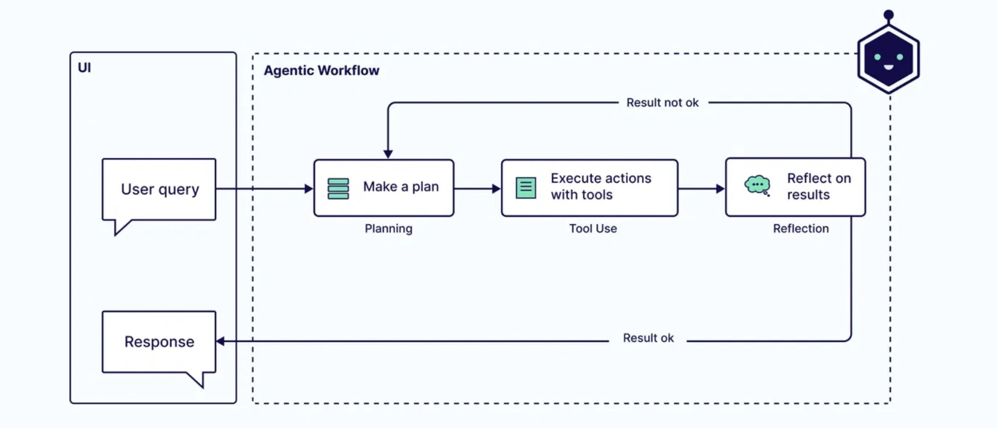
Agentic Applications Pattern Deep Dive
When to Use
Complex tasks requiring multi-step reasoning
Scenarios needing external tool orchestration
Tasks requiring planning and adaptation
Autonomous workflows with minimal supervision
Research, data analysis, and creative tasks
When NOT to Use
Simple queries with direct responses
Low-latency requirements
Highly predictable workflows
Cost-sensitive applications
Strengths & Risks
Scenarios requiring deterministic outcomes
Strengths
Risks
Autonomous task completion
Unpredictable behavior
Complex reasoning capabilities
Higher costs and latency
Complex implementation
Tool integration flexibility
Tool security concerns
Adaptive problem-solving

Slide 10






Agentic Template Architecture
Core Components
Planner/Controller
Decomposes tasks, creates execution plans
Tool Registry
Manages available tools and capabilities
Memory System
Stores context and conversation history
Safety Layer
Enforces permissions and content guardrails
Execution Engine
Orchestrates tool execution and handles results
Recommended Tools
LangChain Agents
AutoGen
Google Vertex AI
Google ADK

Slide 11




Multi-Agent Patterns
Common Multi-Agent Architectures
Supervisor-Worker Pattern
Peer-to-Peer Pattern
A central supervisor agent coordinates specialized worker agents, each with specific capabilities.
Agents collaborate as equals, communicating directly with each other.
No central coordinator; distributed decision-making
Supervisor decomposes tasks and delegates to appropriate workers
Agents negotiate and collaborate autonomously
Workers report results back to supervisor for integration
Highly resilient but potentially complex coordination
Clear chain of command with centralized control
Hierarchical Pattern
Debate Pattern
Multi-level structure with delegation flowing down and results flowing up.
Multiple agents with different perspectives debate to reach consensus.
Top-level agents handle strategic decisions
Agents present arguments and counter-arguments
Mid-level agents manage tactical execution
Judge agent evaluates and determines final output
Leaf agents perform specialized operations
Improves reasoning and reduces biases

Slide 12

Multi-Agent Topologies
Common Agent Topologies
Supervisor (Hub-and-Spoke)
Peer-to-Peer (Network)
A central controller agent coordinates specialized worker agents, delegating tasks and aggregating results.
Decentralized structure where agents communicate directly with each other as equals, sharing information and collaborating.
Best for:
Complex tasks requiring diverse expertise, clear hierarchy
Best for:
Collaborative problem-solving, creative tasks
Hierarchical (Tree)
Assembly Line (Pipeline)
Multi-level structure with delegation chains and specialized sub-teams for complex problem decomposition.
Sequential processing where each agent performs a specific transformation on data before passing it to the next agent.
Best for:
Large-scale projects, nested task decomposition
Best for:
Content transformation, multi-stage processing

Slide 13
Agentic Best Practices
Agent Design Principles
Multi-Agent Coordination
Task Decomposition
Communication Protocols
Break complex tasks into smaller, manageable subtasks for specialized agents or tools.
Establish structured message formats for clear inter-agent communication.
Role Specialization
Safety Guardrails
Assign clear responsibilities to each agent based on their strengths.
Implement permission systems and content filters to ensure responsible operation.
Effective Memory Management
Balance context retention with token efficiency. Implement summarization for long tasks.
Tool Integration
Clear Tool Interfaces
Define precise function signatures with documentation to guide proper tool usage.
Tool Orchestration
Implement mechanisms to coordinate tool usage and optimize execution order.

Slide 14
Agentic AI Design Pattern
Pattern | Description | Ideal Use Case | Frameworks / Examples
Single-Agent | One agent handles entire task end-to-end via a single prompt or tool invocation | Simple Q&A, form filling, single API orchestration | Direct LLM calls, basic LangChain Chains
Supervisor | Central “supervisor” delegates subtasks to specialized sub-agents, then aggregates and validates results | Complex workflows needing specialized steps (e.g., data extraction → validation → summarization) | AWS RoboMaker/Augmented AI, LangGraph Hierarchy
Hierarchical | Multi-level hierarchy: top-level supervisor → mid-level managers → executor agents; layered decision-making | Large, modular enterprise pipelines | LangChain Multi-Agent, Agentic Mesh
Network | Peer-to-peer mesh of agents; no strict hierarchy, agents collaborate dynamically | Interdisciplinary research assistants requiring emergent behavior | Agentic Mesh, custom microservices
Swarm | Many identical agents explore in parallel and vote/aggregate results | Optimization problems, large-scale A/B testing | LangChain Swarm prototypes
Debating | Multiple agents propose independent solutions; a “checker” agent adjudicates or merges outputs to reach consensus | High-stakes decisions (legal reasoning, code review) | Gemini Debating, LangChain multi-agent workflows

Slide 15
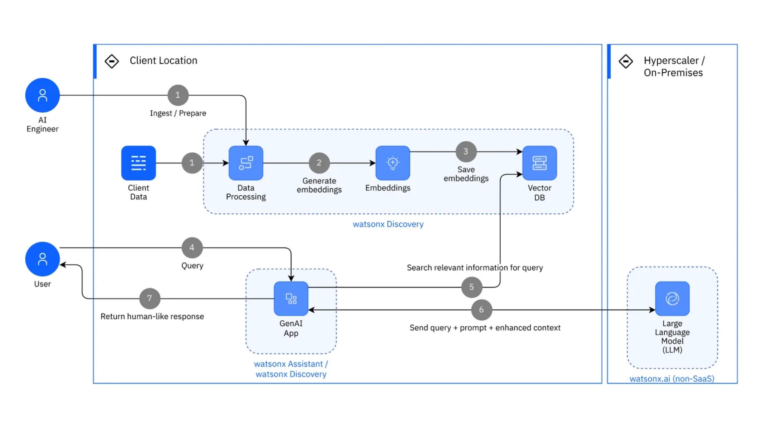


RAG Pattern Overview & Simple RAG
RAG Fundamentals
Retrieval Augmented Generation (RAG) combines retrieval systems with generative AI to produce outputs grounded in accurate information.
Retrieval Stage
Fetches relevant documents from external sources based on the query
Generation Stage
Processes retrieved data and generates a response grounded in the context
Simple RAG Architecture
Key Benefits
Query Input:
User provides a prompt or question
Reduces hallucinations by grounding responses in real data
Document Retrieval:
System searches database for relevant information
Provides up-to-date information without model retraining
Generation:
LLM generates a response grounded in retrieved documents
Enables access to proprietary or domain-specific knowledge

Slide 16
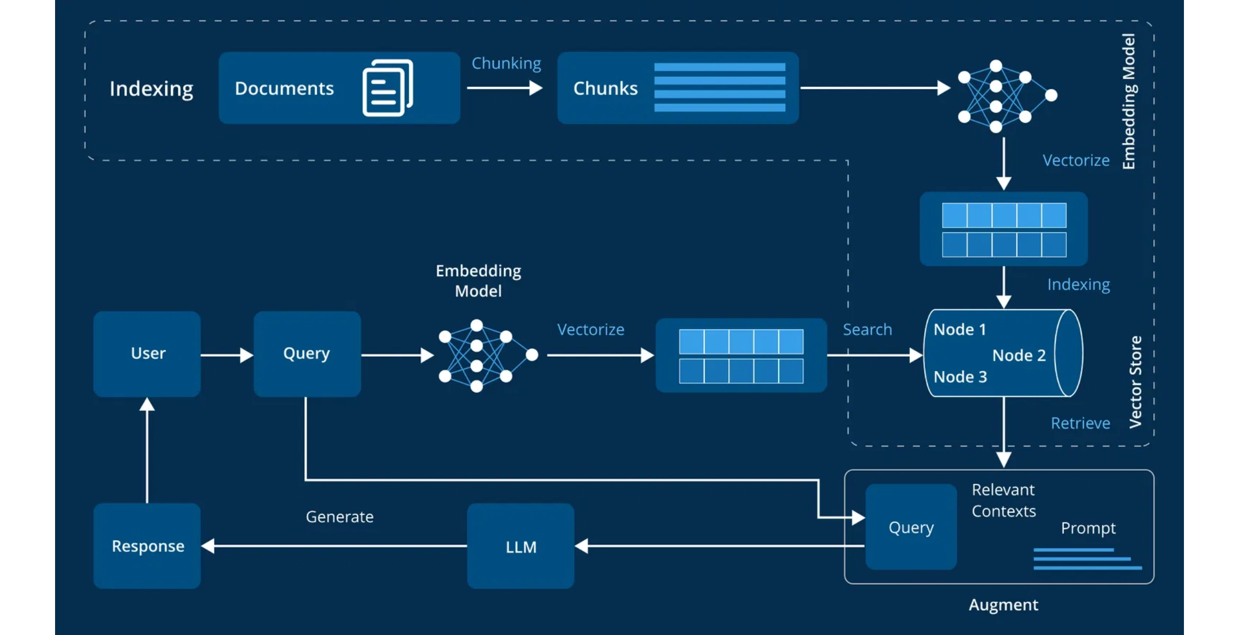




Advanced RAG Patterns
Beyond Simple RAG
Branched RAG
Evaluates queries and selects the most relevant data source(s) instead of querying all available sources.
Use case:
Legal tools, multidisciplinary research requiring specialized knowledge
HyDe (Hypothetical Document Embedding)
Generates hypothetical documents based on queries before retrieving relevant information, using embedded representations to guide retrieval.
Use case:
Research with vague queries, creative content generation
Adaptive RAG
Dynamically adjusts retrieval strategy based on query complexity or nature in real-time.
Use case:
Enterprise search systems with varying query complexity
Self-RAG
Introduces self-retrieval mechanism allowing autonomous generation of retrieval queries during the generation process.
Use case:
Exploratory research, long-form content creation

Slide 17
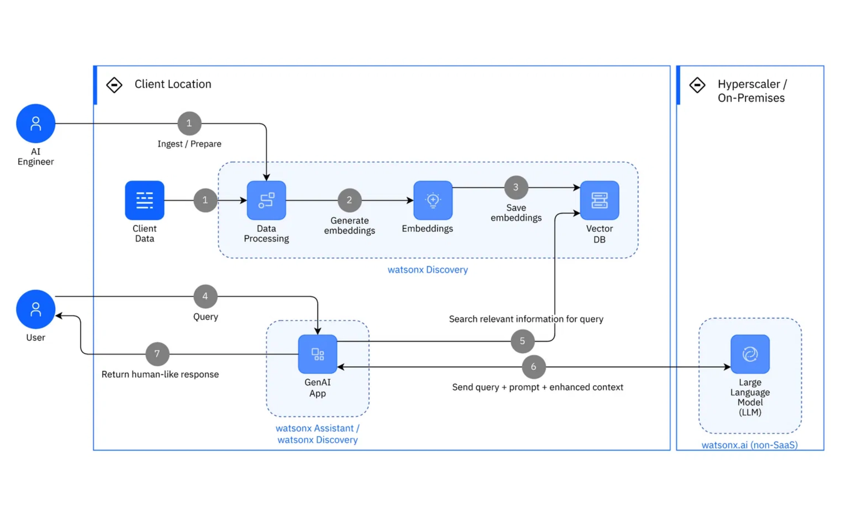



Sophisticated RAG Patterns
Advanced RAG Architectures
Corrective RAG (CRAG)
Self-reflection mechanism on retrieved documents to improve accuracy.
Breaks documents into "knowledge strips" and grades for relevance
Use case:
Legal documents, medical diagnosis support
Agentic RAG
Document Agents orchestrated by a meta-agent for complex tasks.
Each Document Agent handles questions about its document
Use case:
Research, multi-source data aggregation
RAG with Memory
Storage component for contextual awareness across interactions.
Combines retrieved documents with conversation history
Use case:
Customer service, personalized recommendations
Implementation Considerations
Complexity vs. Performance:
More sophisticated patterns require additional resources
Use Case Alignment:
Match pattern complexity to business requirements
Hybrid Approaches:
Combine patterns for specific scenarios

Slide 18
RAG Template Architecture
RAG Pipeline Components
1
Ingestion
Document loading, preprocessing, and metadata extraction
2
Chunking
Splitting documents into semantic units with appropriate size and overlap
3
Embeddings
Converting text chunks into vector representations
4
Vector Store
Indexing and storing vectors for efficient similarity search
5
Retrieval
Finding relevant documents based on query similarity
6
Augmented Prompt
Combining query with retrieved context in structured prompt
7
LLM
Generating response based on augmented prompt
8
Post-processors
Citation generation, formatting, and quality checks

Slide 19
Retrieval Augmented Generation
Vector Databases
Tool | License | Deployment Model | Indexing & Query | Scalability | SDK / Language Support | Best For
Pinecone | Proprietary | Fully managed cloud-only | ANN (HNSW, IVF) + hybrid vector+keyword | Billions of vectors via serverless shards | Python, Go, Java, Node.js, C# | Enterprise-grade similarity search at scale
Weaviate | BSD-3-Clause | Self-host (k8s/Docker) or managed Weaviate Cloud | HNSW (default) & flat indexes; semantic + hybrid via GraphQL/REST | Sharded clusters for billions of vectors | Python, TypeScript/JavaScript, Go, Java | Semantic search & knowledge-graph use cases
Milvus | Apache-2.0 | Embedded, standalone, distributed cluster or Zilliz Cloud | IVF, HNSW, ANNOY; GPU-accelerated indexing & search | Trillion-scale, auto-sharding & independent storage/compute | Python, Java, Go, Node.js, C#, C++ | High-throughput, GPU-accelerated analytics
Qdrant | Apache-2.0 | Self-host (Docker/K8s) or Qdrant Cloud | HNSW with metadata filtering & payload indexes | Sustained high throughput & low latency clusters | Python, Rust, Go, TypeScript, Java, C# | Filterable similarity search in production
Redis Vector Search | Redis Source Available License (RSAL) | Embedded in Redis; self-managed or via Redis Cloud | KNN vector search (HNSW) via FT.SEARCH; vector+text filtering | Scales to billions with sharded clusters & HNSW tuning | Any Redis client: Python, Java, Node.js, Go, .NET | Lightning-fast vector search in existing Redis deployments
ChromaDB | Apache-2.0 | Docker, serverless (Cloud Run) or embed in Python app | In-memory ANN (HNSW) + persistent object store; cosine/Euclidean | Suited for small to medium projects & prototyping | Python | Lightweight prototyping & small-scale similarity apps
Faiss | MIT License | Embedded/in-process library | Exact (Flat) & ANN (IVF, HNSW, PQ) with GPU acceleration | Handles billions of vectors with CPU & GPU support | Python, C++ | High-performance research & large-scale similarity search
Azure Cognitive Search | Proprietary (Microsoft-managed PaaS) | Fully managed cloud PaaS | Nearest Neighbors ANN on vector fields | Scales via search units (partitions & replicas) for millions of docs & vectors | .NET, Java, Python, JavaScript, REST API | Enterprise-grade PaaS vector search integrated with Azure

Slide 20
RAG Best Practices
Document Processing
Generation & Response
Optimal Chunking Strategy
Structured Prompting
Use semantic chunking with appropriate size (150-500 tokens) and overlap (10-20%).
Use clear prompt templates with separate sections for context, query, and instructions.
Metadata Enrichment
Source Attribution
Add metadata to chunks for filtering and relevance scoring.
Include citations linking to source documents to prevent hallucinations.
Embedding Selection
Self-Consistency Checks
Choose domain-appropriate embedding models.
Implement verification steps to validate response against retrieved context.
Retrieval Optimization
Hybrid Search
Combine semantic (vector) and keyword (BM25) search for better recall.
Re-ranking
Apply cross-encoders or LLM-based re-ranking to improve precision.

Slide 21

Mother Architecture Framework
Universal Architectural Layers
Channel/Client
Web, Mobile, Voice, CLI interfaces
Gateway/API
APIM, FastAPI, authentication, routing
Policy & Guardrails
PII scrubbing, prompt injection protection, content filters
Reasoning Layer
LLM/Agents/Chains for processing and generation
Knowledge Layer
Vector DB / Search / Graph for information retrieval
Tool Layer
Functions, REST APIs, DB access, ML models
Observability
Tracing, logs, metrics, evaluation
Ops & FinOps
Scaling, cost management, tenancy, secrets

Slide 22
Pattern Selection Decision Tree - Part 1
Key Decision Points
Q1: Do outputs require grounding on enterprise/private data?
Does your application need to reference specific documents, databases, or proprietary information?
Y
Yes →
RAG or Hybrid approach
N
No →
Continue to Q2
Q3: Are tools/APIs and planning required?
Does your application need to use external tools or perform complex multi-step planning?
Q2: Is there a deterministic business flow or approvals?
Does your process follow a predictable sequence with defined steps or approval gates?
Y
Yes →
Agentic
N
No →
Prompt-based MVP
Y
Yes →
Static Workflow
N
No →
Continue to Q3

Slide 23




Pattern Selection Decision Tree - Part 2 (Edge Cases)
Special Considerations
Low-Latency, Fixed UX Requirements
Choose
Prompt-based
or
Static Workflows
when:
Response time is critical (sub-second)
User interface needs predictable outputs
High Variance Tasks, Tool Orchestration
Hybrid Recommendations
Choose
Agentic
pattern when:
RAG + Agent:
Ground responses in enterprise data while enabling tool use
Tasks vary significantly between requests
Multiple external tools need coordination
Prompt-based for UI polish:
Use simple prompting to refine outputs
Compliance & Auditability
Choose
RAG
pattern (with logging/guardrails) when:
Responses must be grounded in approved content
Source attribution is required

Slide 24
Prompting Frameworks

Slide 25
RISE Framework
R - Role
Define AI's expertise and perspective with specific professional role
I - Instructions
Clear, action-oriented directive using specific verbs
S - Scenario
Provide context, constraints, and relevant parameters
E - Examples
Show desired output format or style with concrete examples
Best for: Structured tasks requiring specific expertise and clear deliverables

Slide 26
RACE Framework
R - Role
Establish AI's professional identity and domain expertise
A - Action
Define the specific task or deliverable to be produced
C - Context
Provide background, constraints, and relevant parameters
E - Expectations
Specify format, structure, quality criteria, and success metrics
Best for: Professional tasks requiring domain expertise and business-ready outputs

Slide 27
Additional Prompting Frameworks
• ROSES: Role, Objective, Style, Example, Scenario - Creative projects with brand consistency
• TRACE: Task, Requirements, Audience, Context, Evaluation - Complex analysis with QC
• COAST: Context, Objective, Audience, Style, Tone - Audience-focused communication
• APE: Action, Purpose, Expectation - Beginner-friendly for 80% of tasks
• RISEN: Role, Instructions, Steps, Expectations, Narrowing - Multi-step with constraints
• CRISPE: Context, Role, Instructions, Style, Personalization, Examples - Tonal control

Slide 28
Framework Selection Guide
BEGINNER - Quick Tasks
Use APE for rapid prototyping and routine operations
INTERMEDIATE - Professional
Use RACE, RISE, COAST for business reports and analysis
ADVANCED - Complex
Use TRACE, RISEN for technical analysis and validated outputs
CREATIVE - Brand Content
Use ROSES, CRISPE for marketing and brand-aligned content

Slide 29
LLM Evaluation Metrics
Key Evaluation Categories
Accuracy & Factuality
Reasoning
Measures correctness of information
Evaluates logical thinking ability
Text Quality
Safety & Alignment
Assesses coherence and fluency
Measures ethical adherence
Task Performance
Efficiency
Evaluates domain effectiveness
Measures speed and resource usage
Evaluation Approaches
LLM-as-Judge
Human Evaluation
Using stronger LLMs to evaluate outputs
Expert assessment of outputs

Slide 30
Pattern Evaluation Framework
Key Evaluation Dimensions
Performance
Cost Efficiency
Latency and throughput
Total cost of ownership
Output Quality
Implementation
Accuracy and relevance
Development complexity
Security & Compliance
Data protection and regulatory alignment
Evaluation Process
Define Requirements
Weight Criteria
Set clear objectives
Prioritize dimensions
Prototype & Test
Measure & Compare
Gather empirical data
Analyze against requirements

Slide 31
Advanced Evaluation Techniques
Automated Evaluation Methods
LLM-as-Judge
Pairwise Comparison
Using stronger LLMs to evaluate outputs
Side-by-side output comparison
Benchmark Suites
Adversarial Testing
Standardized capability tests
Edge case challenges
Human-in-the-Loop Evaluation
Expert Review
User Feedback
Domain specialist evaluation
End-user satisfaction analysis

Slide 32
Operational Metrics for GenAI Systems
Key Performance Indicators
Pattern-Specific Metrics
Latency & Response Time
Throughput & Capacity
Prompt-Based Systems
Static Workflows
End-to-end processing time
Requests processed per time
Token usage efficiency
Step completion rates
Cost Metrics
Error Rates
RAG Systems
Agentic Systems
Financial impact of operation
System failures frequency
Retrieval latency, relevance
Tool usage, planning efficiency
Monitoring Best Practices
Multi-Level Observability
Proactive Alerting
Monitor all system layers
Early warning systems

Slide 33

GenAI Application Pattern
🎯 Prompt-Based Solution
🔗 Chain-Based Automation
🤖 Agentic AI Solution
📚 RAG (Retrieval-Augmented Generation)
🎓 Fine-Tuning LLM
Best for: Simple, single-step tasks
Best for: Multi-step processes with fixed sequence
Best for: Dynamic, autonomous decision-making
Best for: Dynamic knowledge that changes frequently
Best for: Static, specialized domain expertise
Use when:
Direct input → output (translation, summarization, classification)
No intermediate processing needed
Quick prototyping or MVP development
Use when:
Deterministic business workflows
Each step depends on the previous one
Predictable sequence of operations
Use when:
Non-deterministic processes
Need planning and reasoning capabilities
Tool usage and external API integration required
Use when:
External knowledge base needed
Information updates regularly
Context-aware responses required
Use when:
Deep domain-specific knowledge required
Specialized terminology and jargon
Knowledge rarely changes
Examples: Text translation, email drafting, content summarization
Examples: Document processing pipeline, data extraction → validation → formatting
Examples: Research assistants, adaptive workflow automation, complex problem-solving
Examples: Customer support, document Q&A, policy inquiries
Examples: Medical diagnosis, legal document analysis, technical writing
Implementation: Direct API calls to LLM providers (OpenAI, Google Vertex AI)
Frameworks: LangChain, LangGraph, AutoGen
Frameworks: AutoGen, LangGraph Agents, CrewAI
Components: Vector database + Embeddings + LLM
Requirements: Significant compute resources and training data

Slide 34
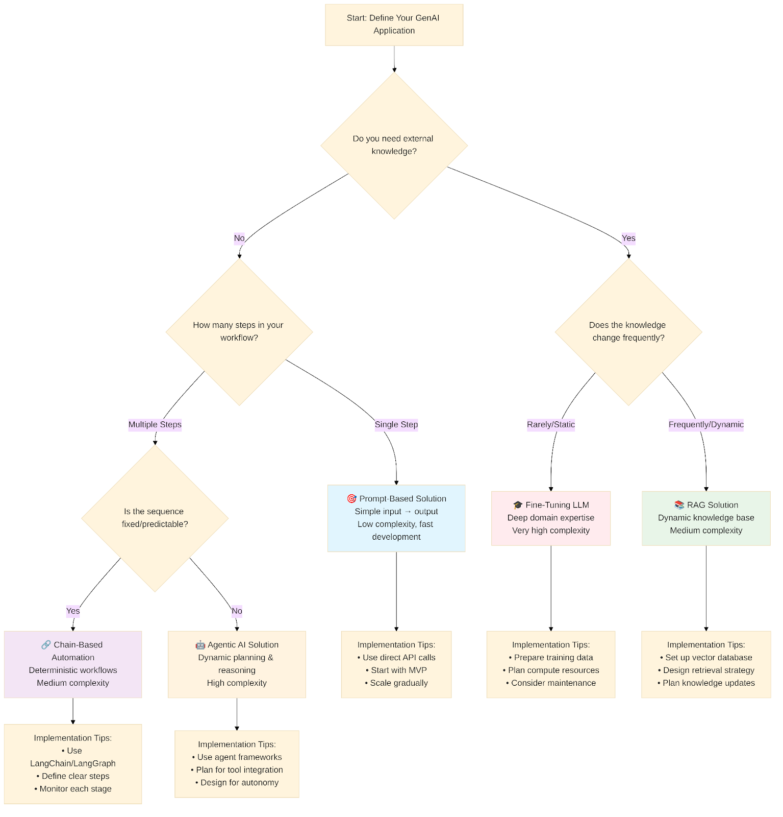
GenAI Application Pattern

Slide 35
GenAI Application Pattern
Pattern | Development Complexity | Update Effort | Latency | Cost
Prompt-Based | ⭐ Very Low | ⭐ None | ⭐ Very Low | ⭐ Low
Chain Automation | ⭐⭐ Low-Medium | ⭐⭐ Moderate | ⭐ Low | ⭐⭐ Medium
RAG | ⭐⭐⭐ Medium | ⭐ Low | ⭐⭐ Medium | ⭐⭐ Medium
Agentic AI | ⭐⭐⭐⭐ Medium-High | ⭐⭐⭐ High | ⭐⭐ Medium | ⭐⭐⭐ High
Fine-Tuning | ⭐⭐⭐⭐⭐ Very High | ⭐⭐⭐⭐⭐ Very High | ⭐⭐ Low-Medium | ⭐⭐⭐⭐⭐ Very High

Slide 36
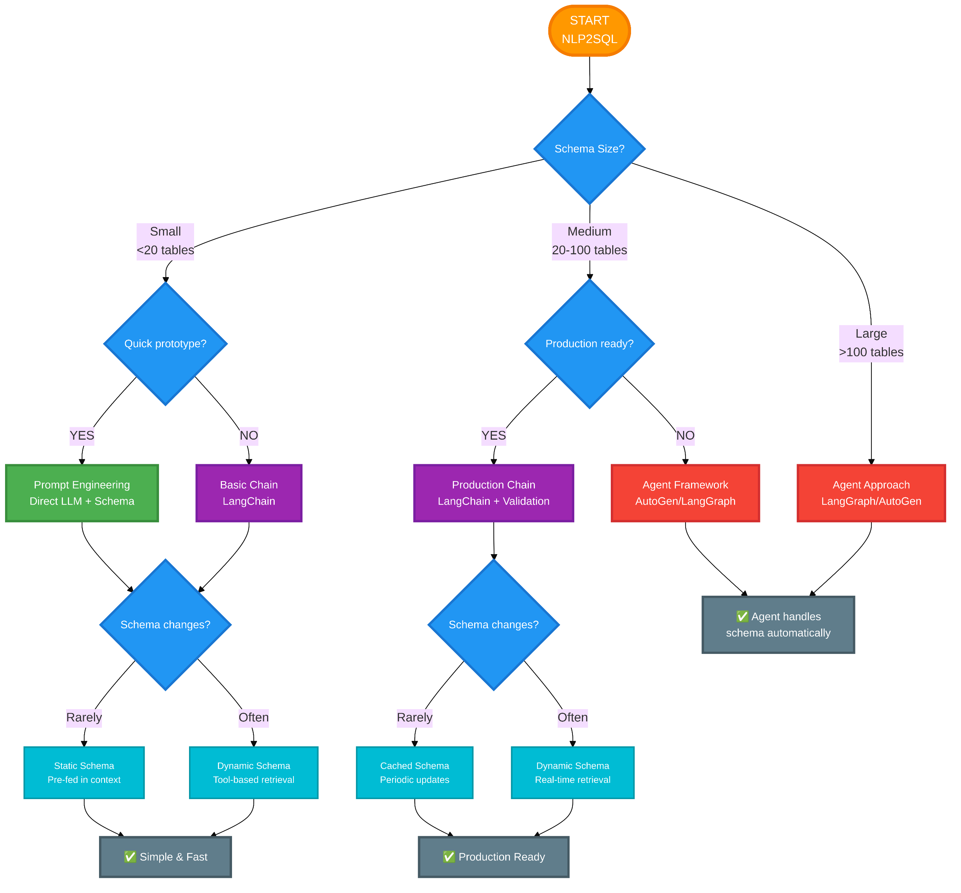
NLP2SQL

Slide 37
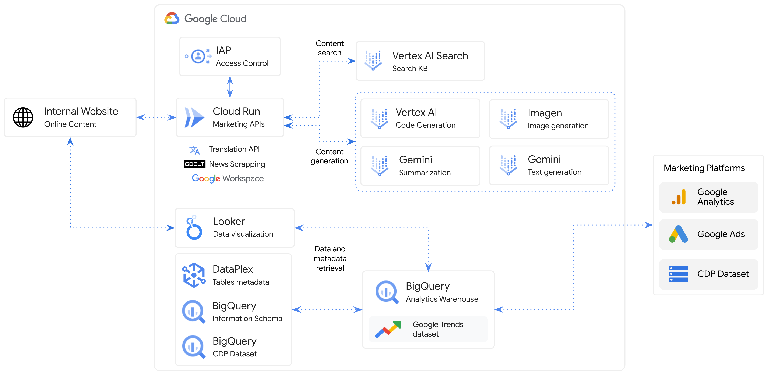
Generative AI for Marketing Using Google Cloud
This repository showcases the application of Google Cloud's Generative AI to marketing scenarios. It contains detailed, step-by-step instructions to deploy a solution implementing marketing-centric Generative AI capabilities, including capabilities to craft marketing materials like blog posts and social media content. This video walks through the functionality in the solution.
https://github.com/GoogleCloudPlatform/genai-for-marketing

Slide 38
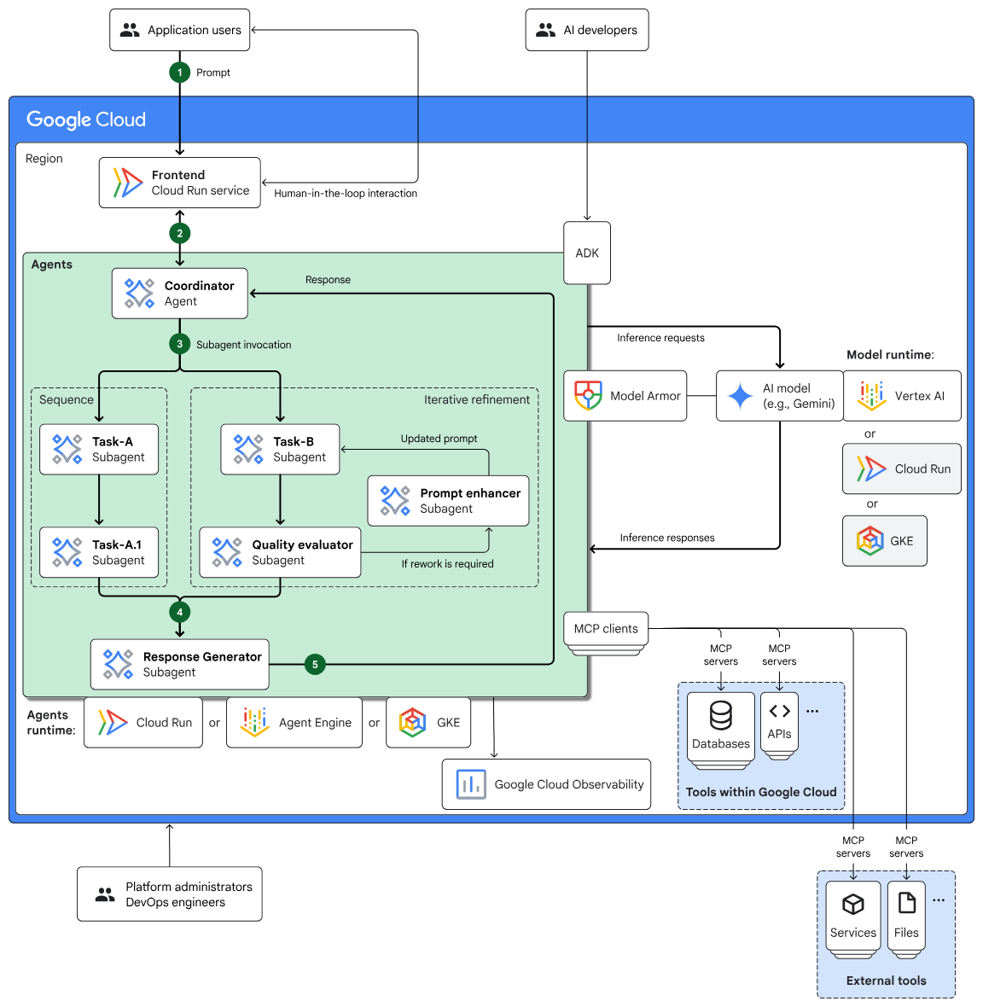
Multi-agent AI system in Google Cloud

Slide 39
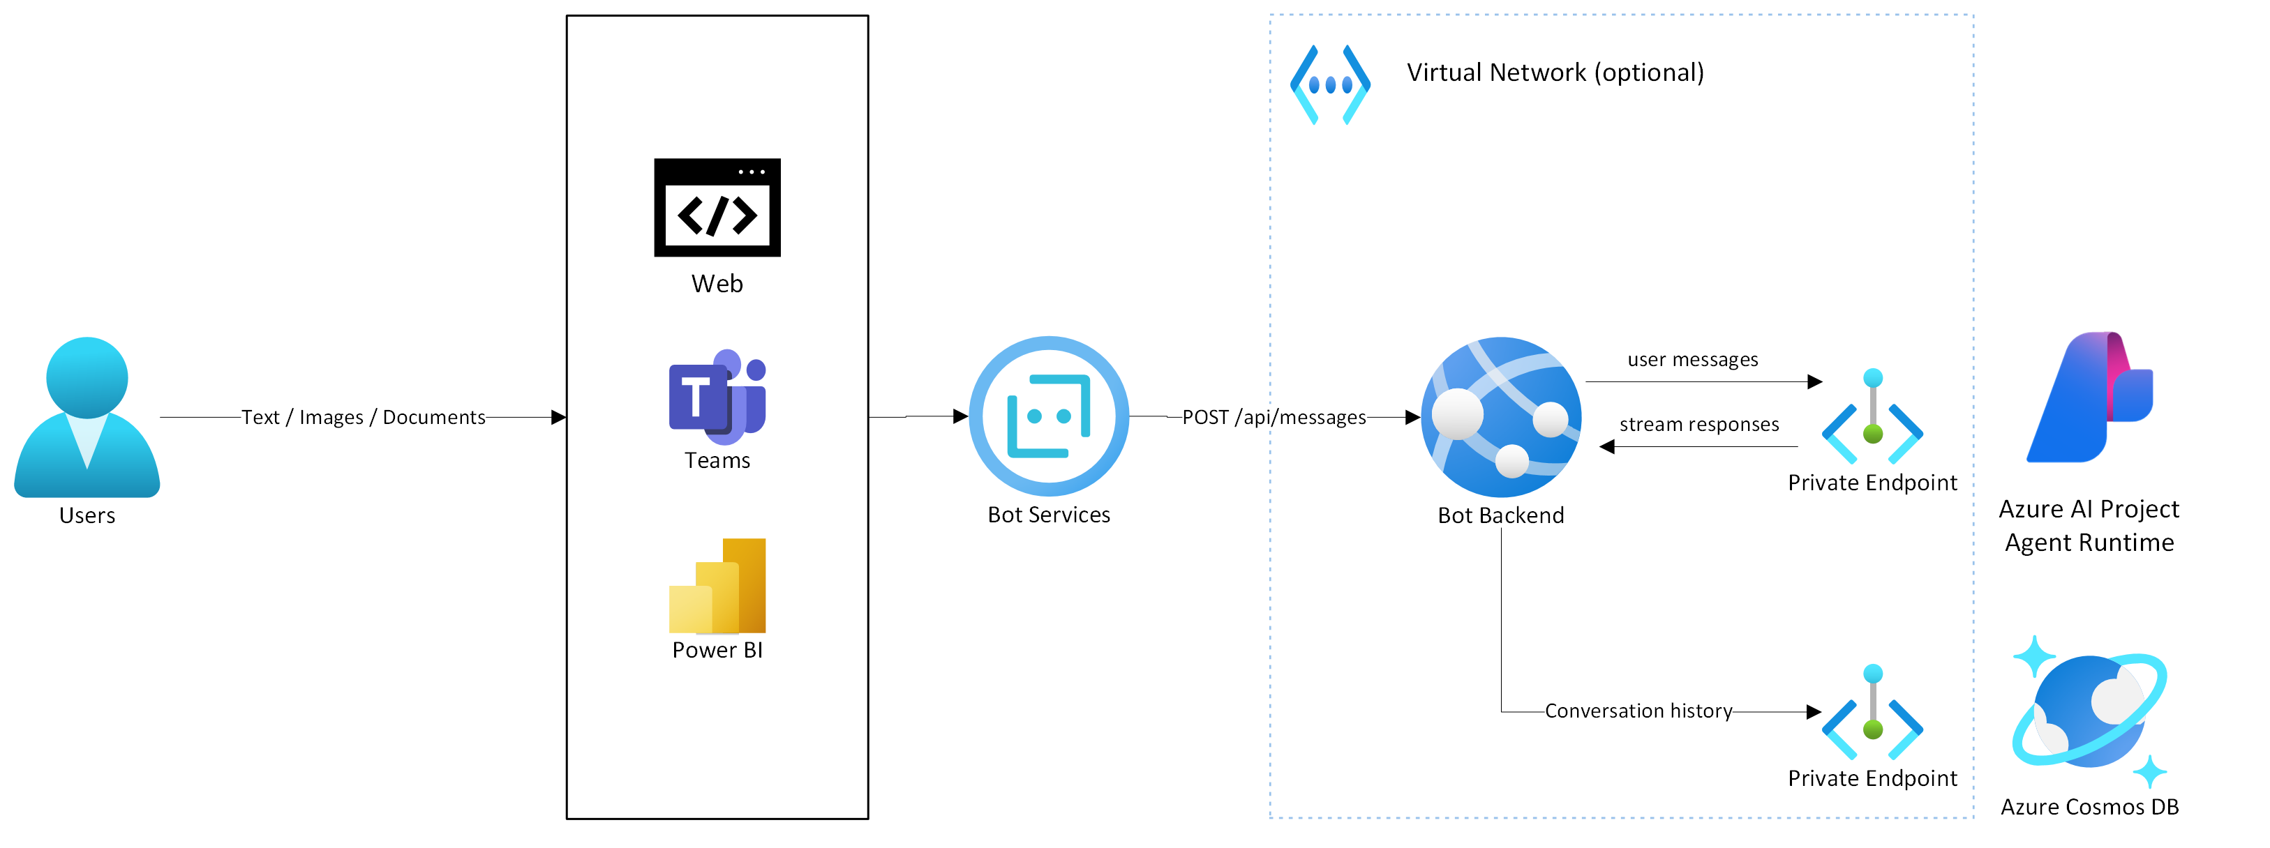
Azure Agents Travel Assistant
End-to-end sample of a travel agent implemented with Azure AI Agent Service and Bot Framework. The travel assistant leverages the Azure AI platform to understand images and documents, providing assistance during travel planning and common travel situations. Key features include:
Image Recognition: Identify landmarks, extract text from travel documents, and more.
Document Understanding: Parse itineraries, booking confirmations, and other travel-related documents.
Travel Assistance: Offer recommendations, reminders, and support for various travel scenarios.
https://github.com/Azure-Samples/azureai-travel-agent-python

Slide 40
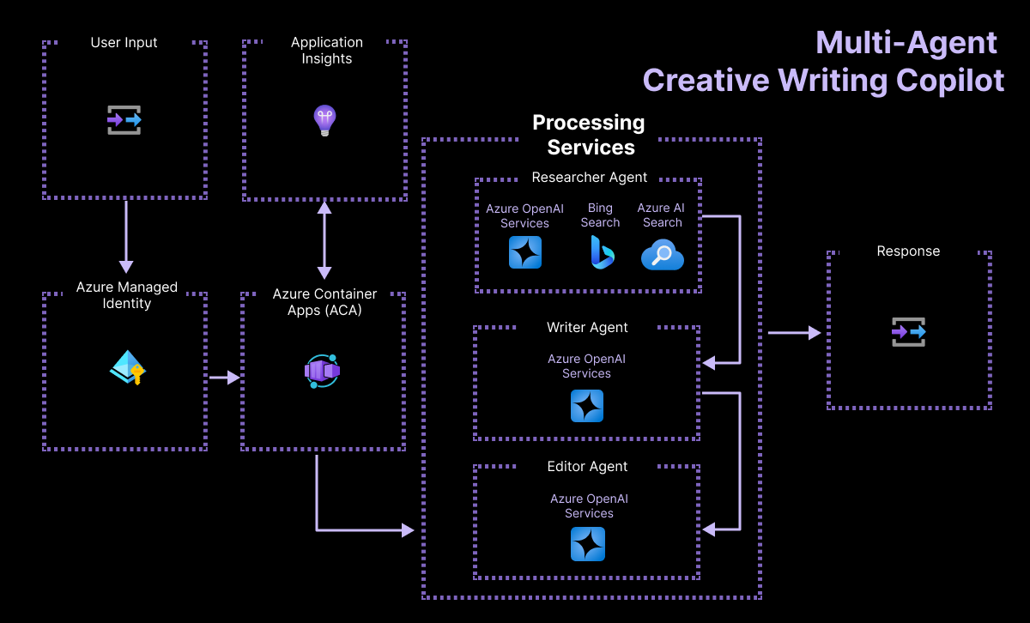
Creative Writing Assistant: Working with Agents
Contoso Creative Writer is an app that will help you write well researched, product specific articles. Enter the required information and then click "Start Work". The result will begin writing once the agents complete the tasks to write the article.
It includes a FastAPI app that takes a topic and instruction from a user and then calls a research agent that uses the Bing Grounding Tool in Azure AI Agent Service to research the topic, a product agent that uses Azure AI Search to do a semantic similarity search for related products from a vector store, a writer agent to combine the research and product information into a helpful article, and an editor agent to refine the article that's finally presented to the user.
https://github.com/Azure-Samples/contoso-creative-writer

Slide 41
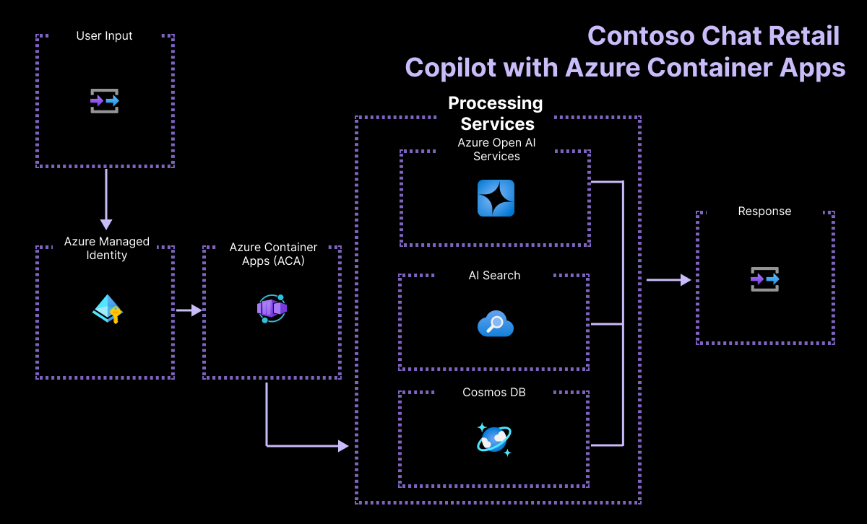
Contoso Chat: Retail RAG Copilot
Contoso Outdoor is an online retailer specializing in hiking and camping equipment for outdoor enthusiasts.
The website offers an extensive catalog of products - resulting in customers needing product information and recommendations to assist them in making relevant purchases.
This sample implements Contoso Chat - a retail copilot solution for Contoso Outdoor that uses a retrieval augmented generation design pattern to ground chatbot responses in the retailer's product and customer data.
Customers can ask questions from the website in natural language, and get relevant responses with potential recommendations based on their purchase history - with responsible AI practices to ensure response quality and safety.
https://github.com/Azure-Samples/contoso-chat

